Slide 1



The Tech #semanticClimate Wants (and Builds)
Shweata Hegde and #sC Team
@shweataHegde
Shweata N. Hegde
https://semanticclimate.github.io/p/en/

Slide 2
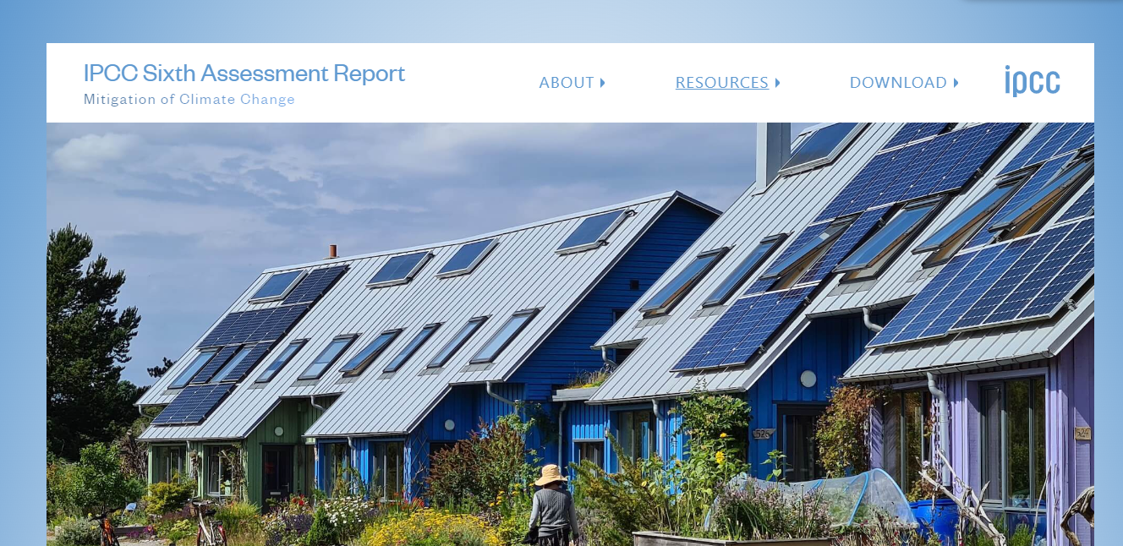
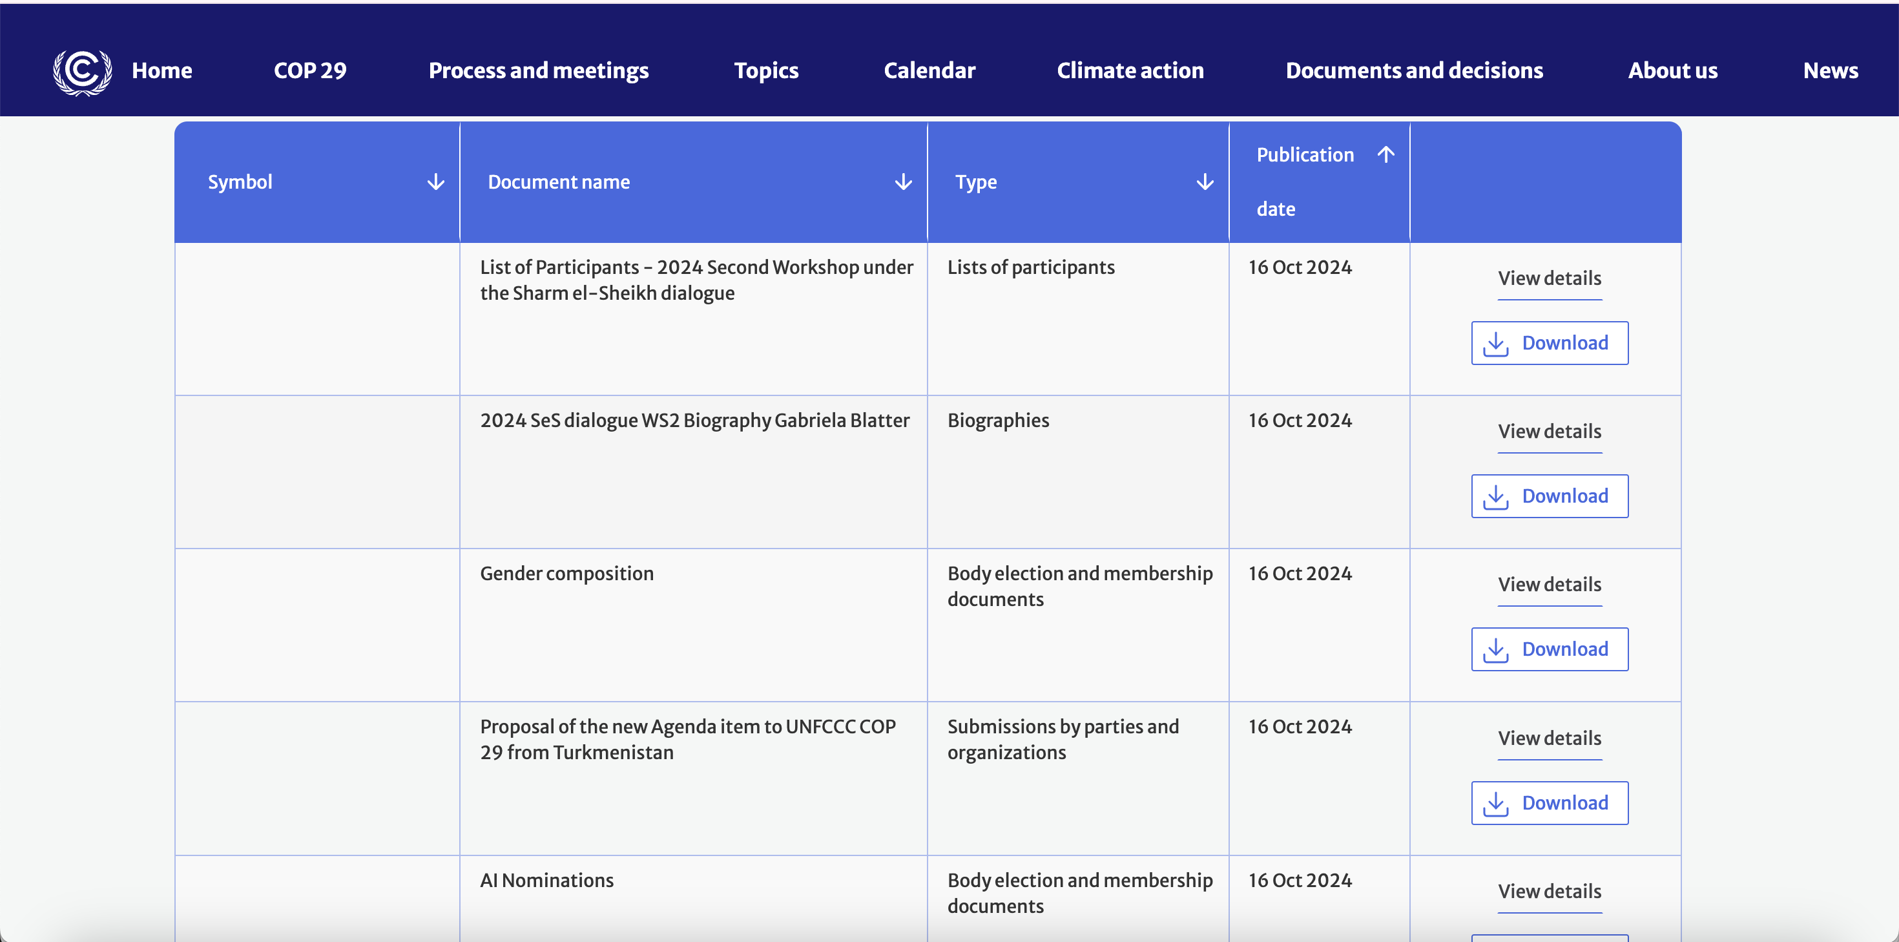

So much climate knowledge!
IPCC Reports
(10000+ pages)
UNFCCC Documents
(1000 Pages)

Slide 3

PDFs are not sustainable (1-star); knowledge locked up; cause massive wastage
< >
Scraped
HTML
IPCC Reports
(10000+ pages)
UNFCCC Documents
(1000 pages)

Slide 4
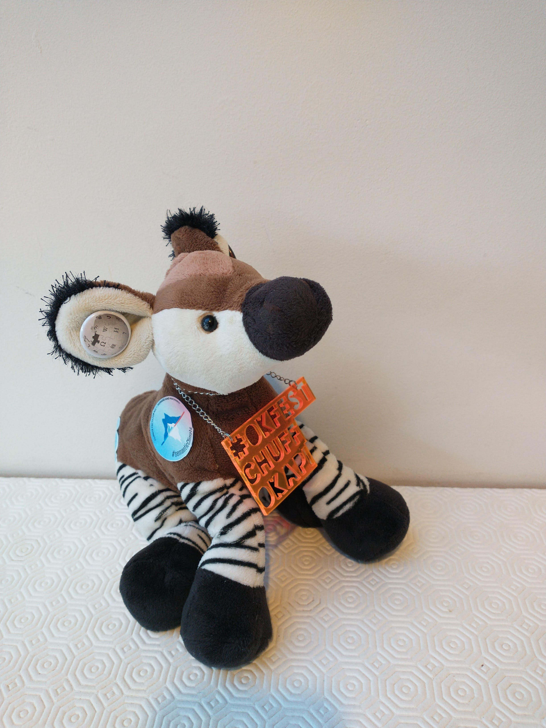
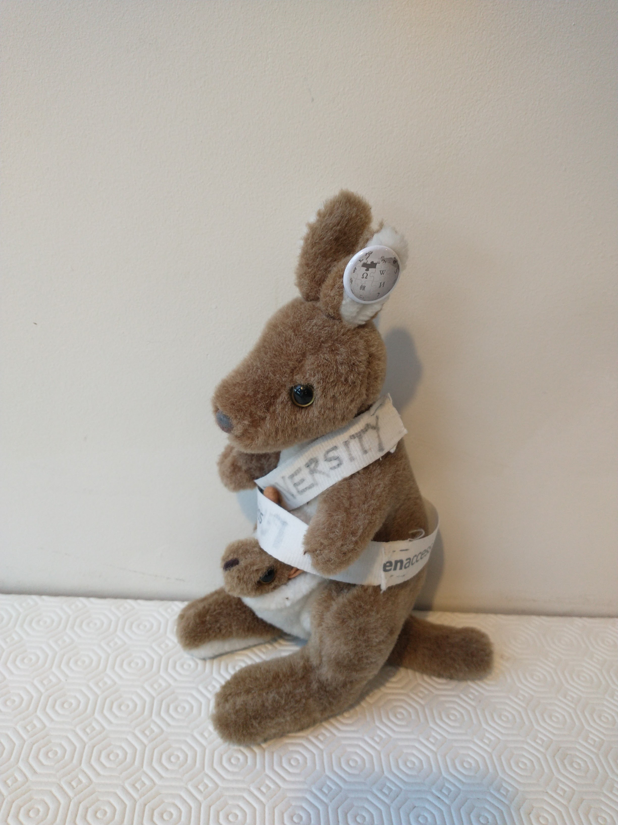
You’ve come to the right person, Chuff. I can turn the PDFs into a semantic 5-star documents so the knowledge is usable
AMI, need your help. What do we do with these PDF?

Slide 5
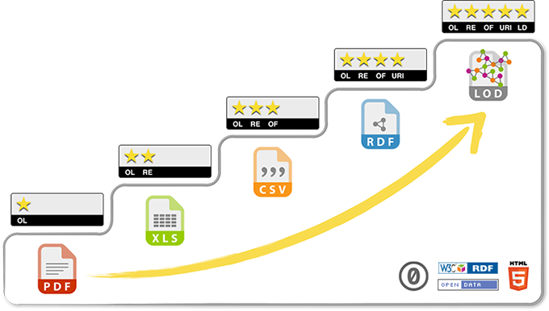
What Do We Mean by 5-star Document?
5-star -- Semantic HTML + Unique Identifiers + Annotation
Tim Berners-Lee’s Classification

Slide 6
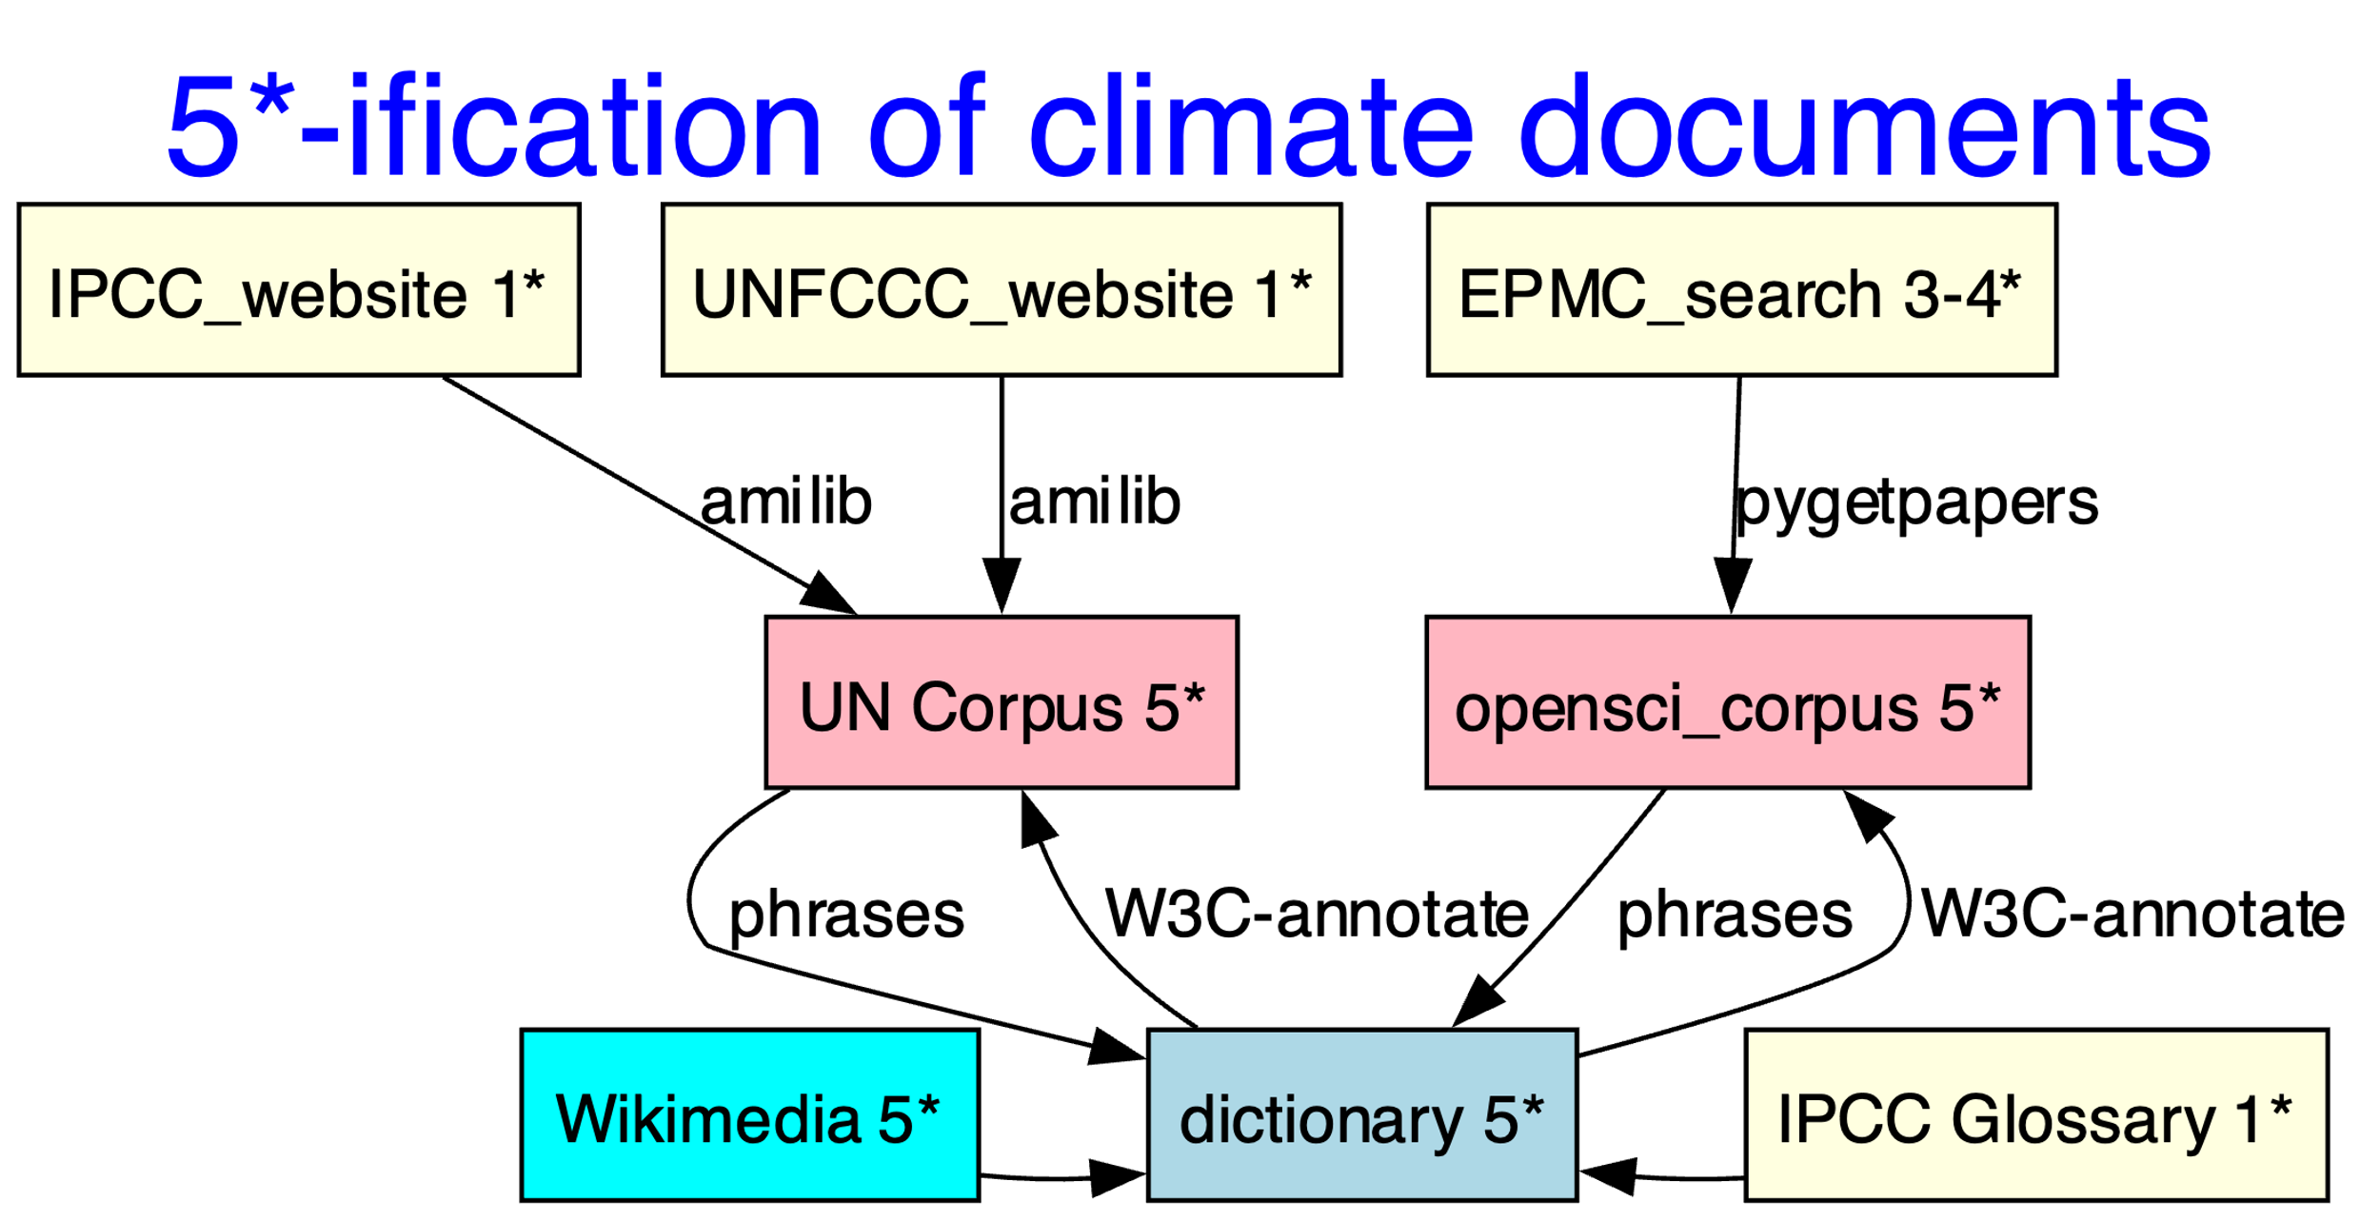
#semanticClimate, with AMI’s help, builds tools to create Linked Open Documents (5-star)
Notes:
We built a 5-starification “engine”. Climate documents are one star from the UN and 3 star from EPMC. We convert them into consist 5 star documents and dictionaries with the help of dictionaries.

Slide 7
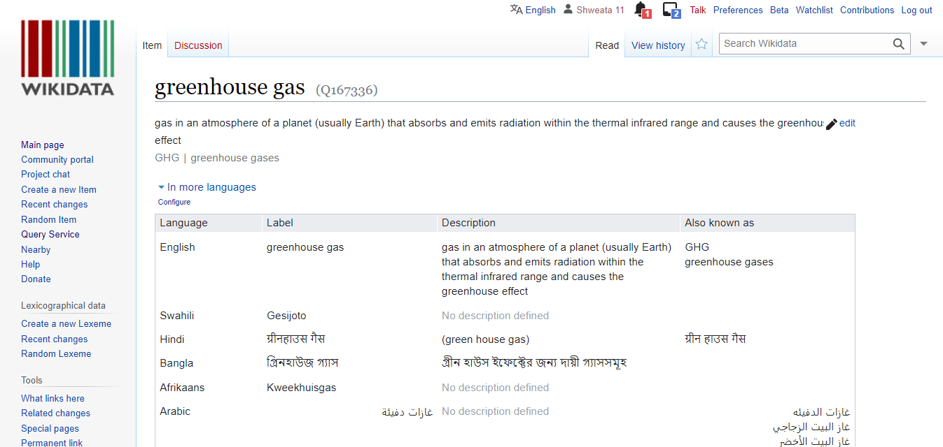
5-star Dictionary
<entry name="VRE" term="Variable Renewable Energy" wikidataID=“Q7915732”/>
<entry name=“NDC" term=“Nationally Determined Contributions" wikidataID=“Q20051297”/>
<entry name=“GHG" term=“Greenhouse Gas" wikidataID=“Q167336”/>
Different languages!

Slide 8
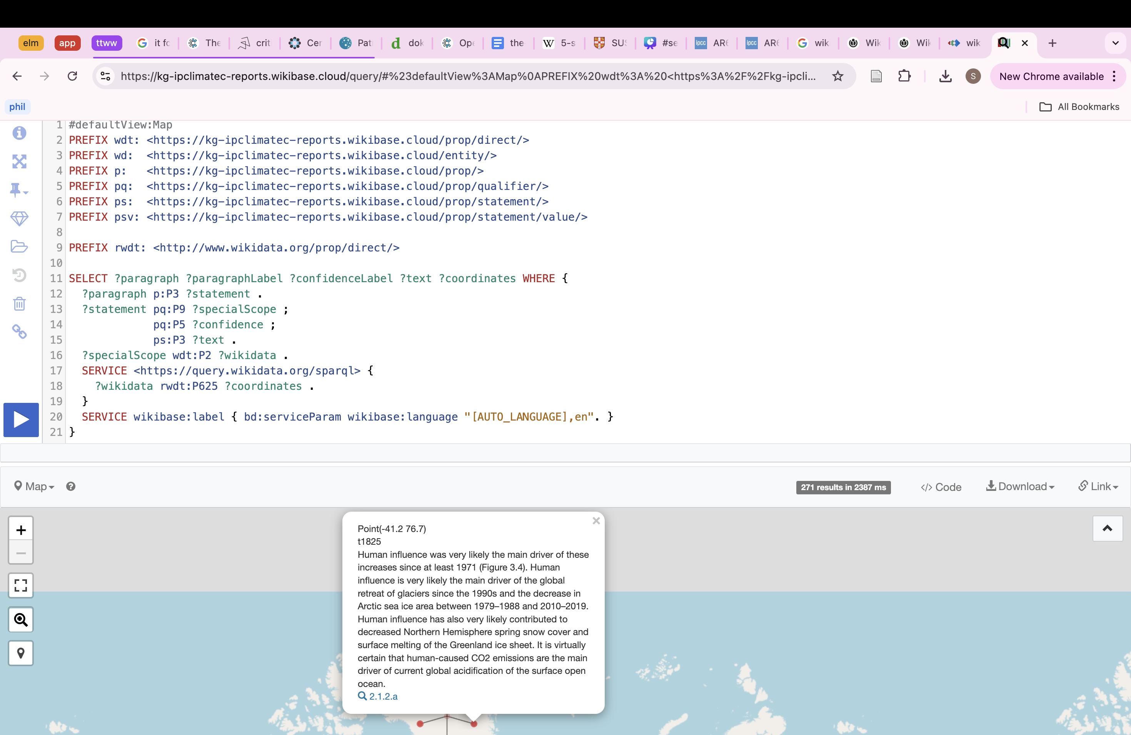
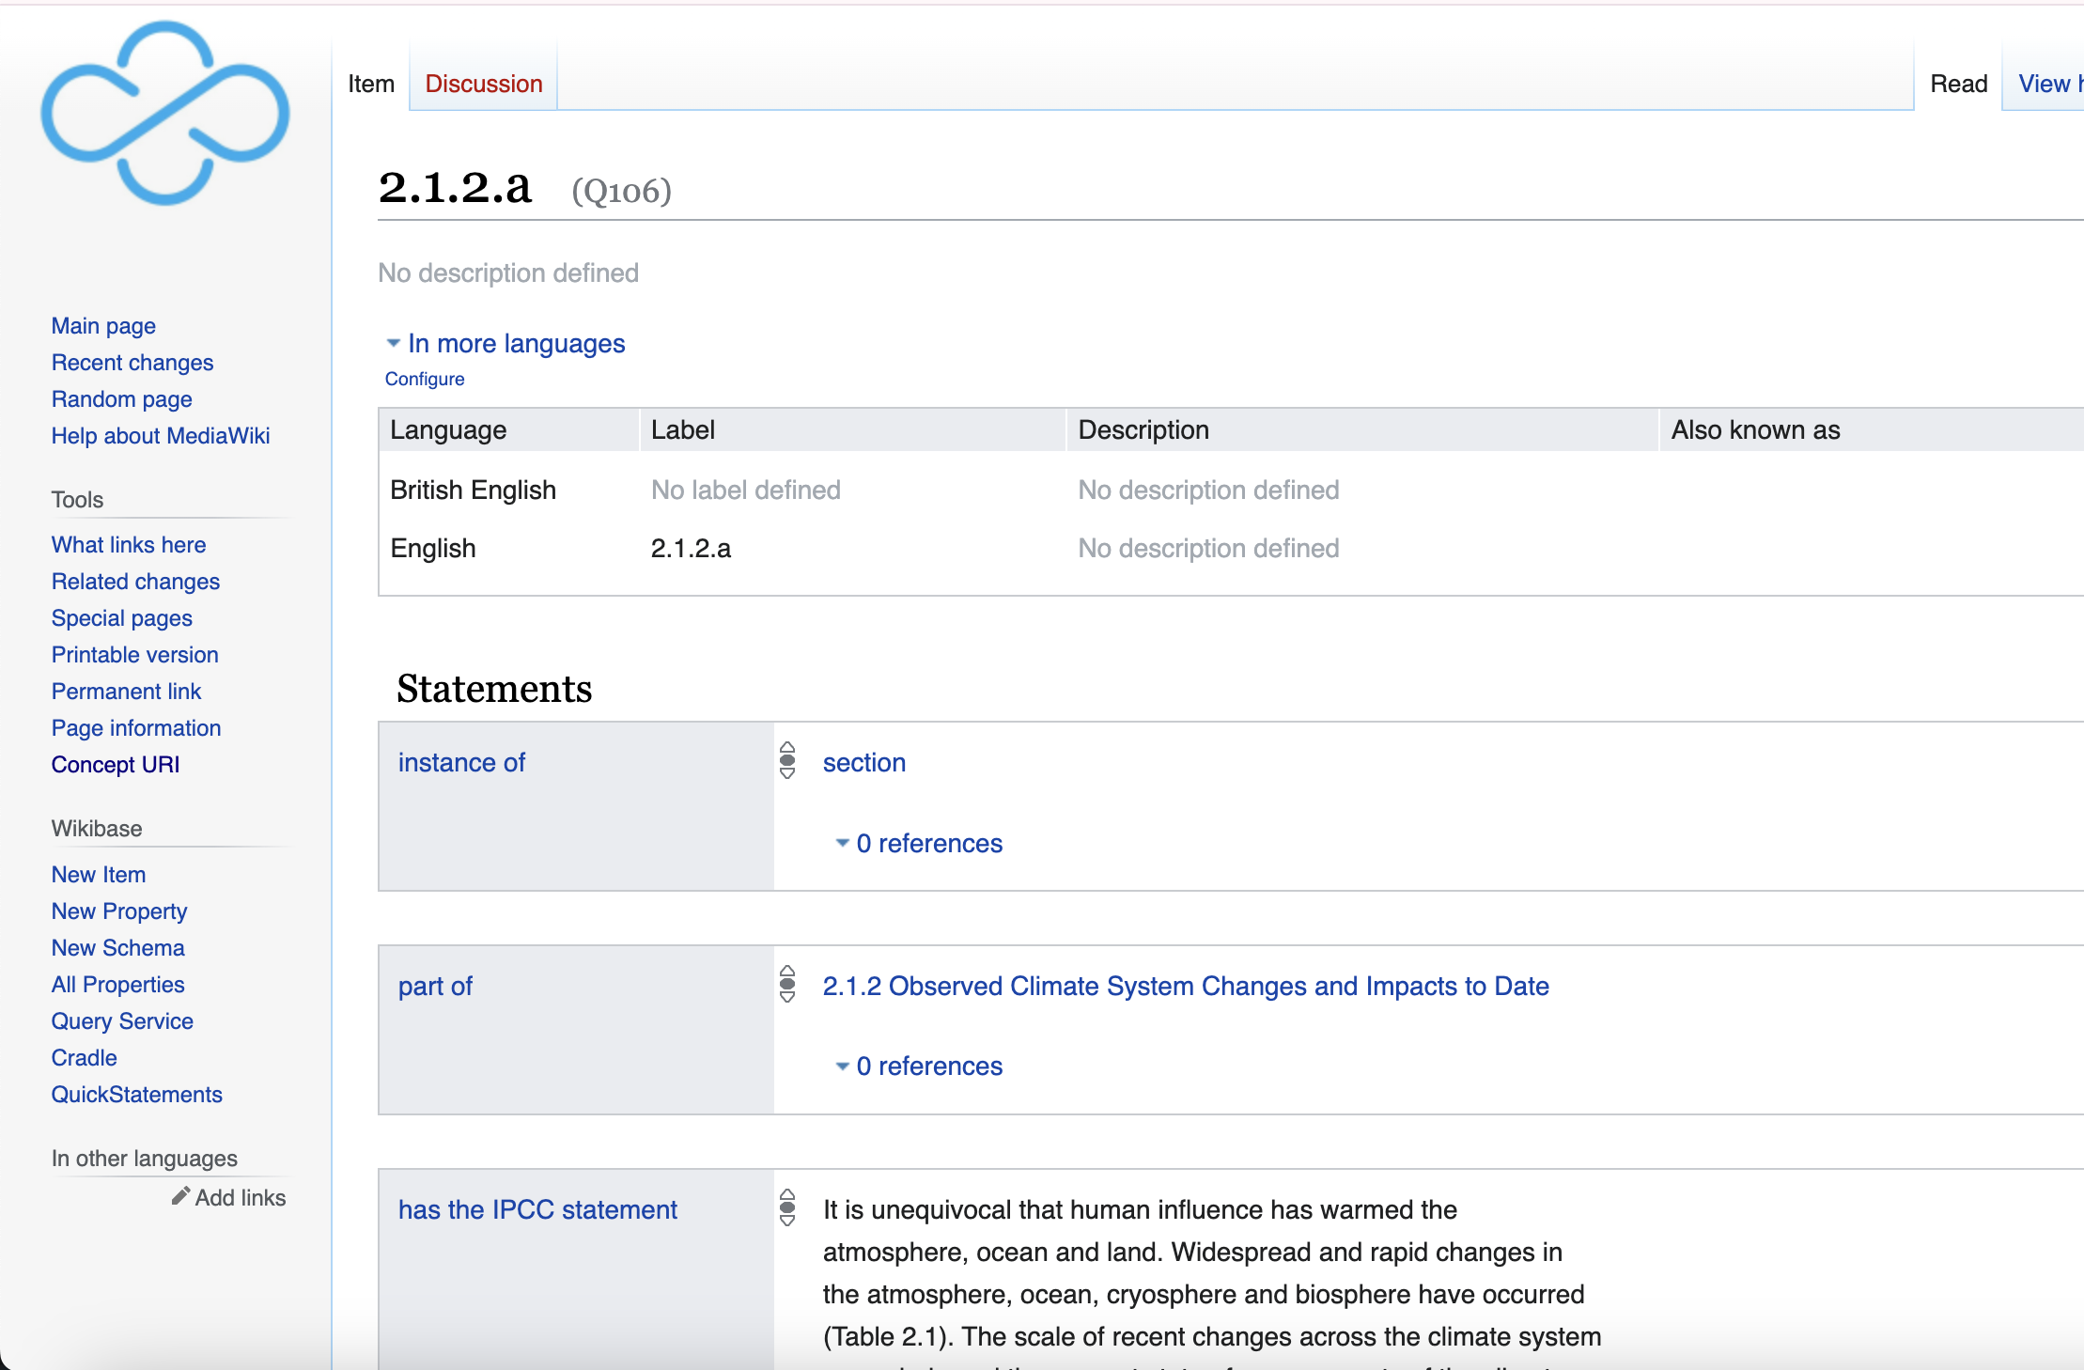
Wikibase for Climate Knowledge (4-star)
https://kg-ipclimatec-reports.wikibase.cloud/wiki/Item:Q106

Slide 9
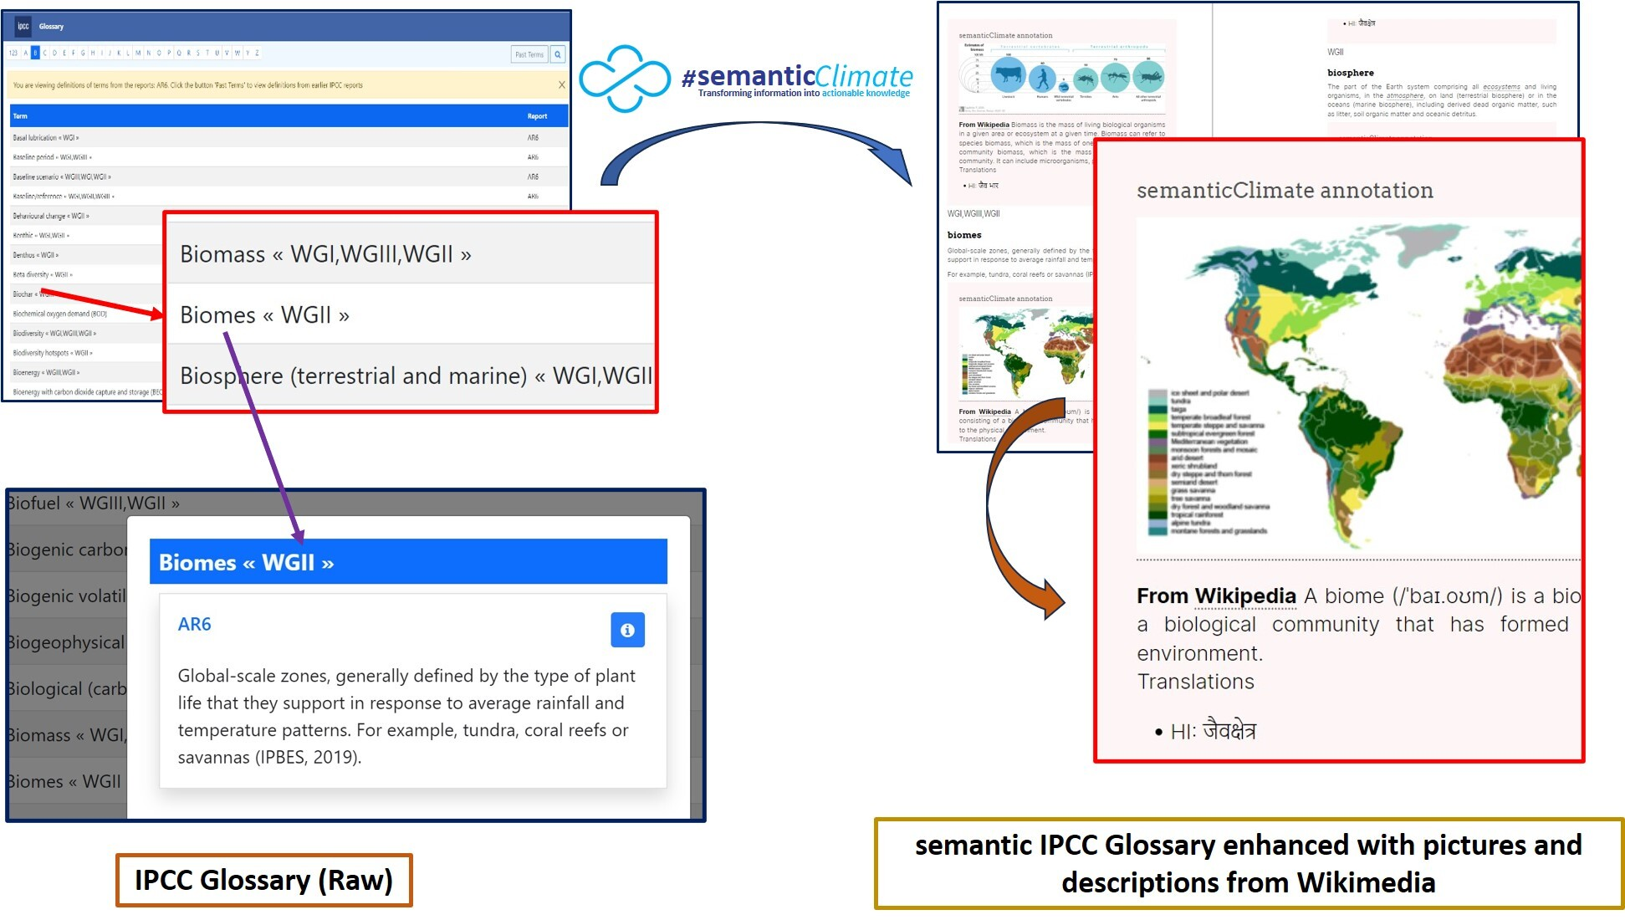
IPCC Glossary (5-Star)

Slide 10
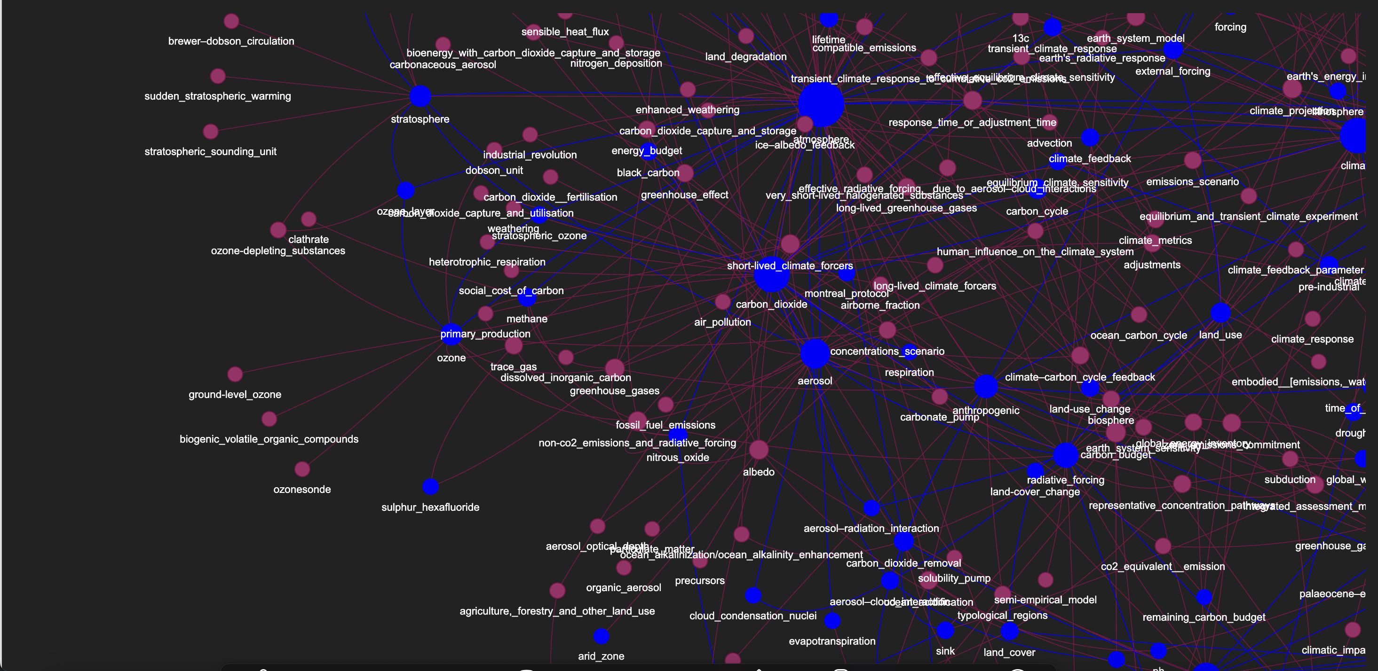
Glossary Knowledge Graph

Slide 11
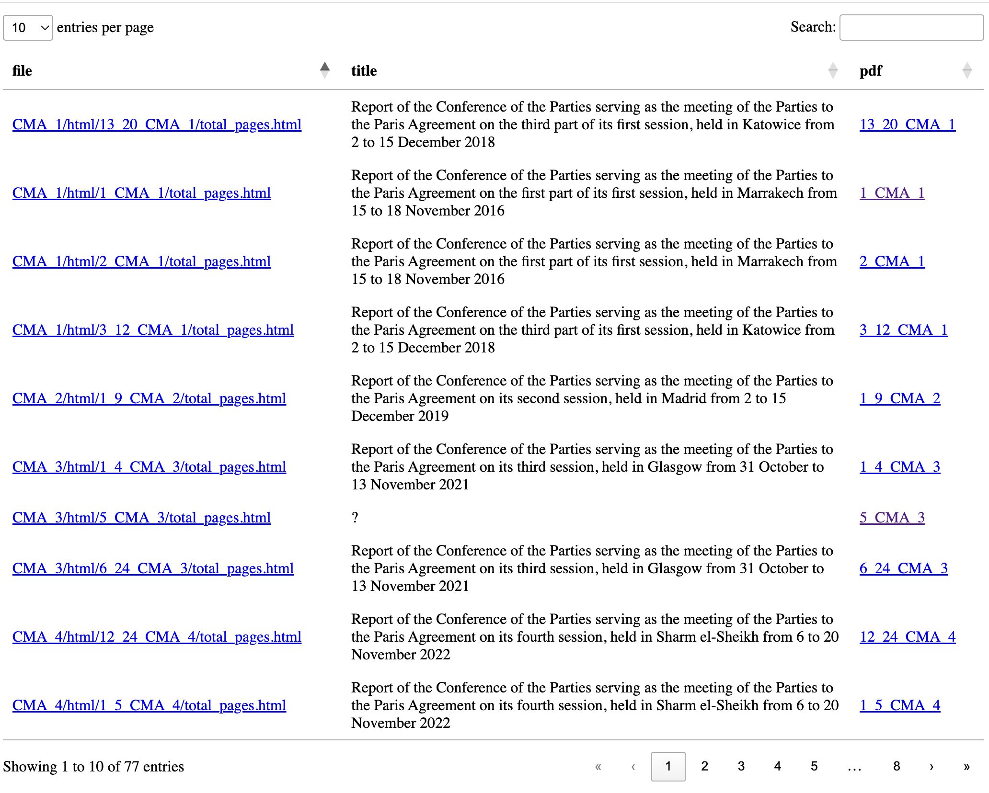
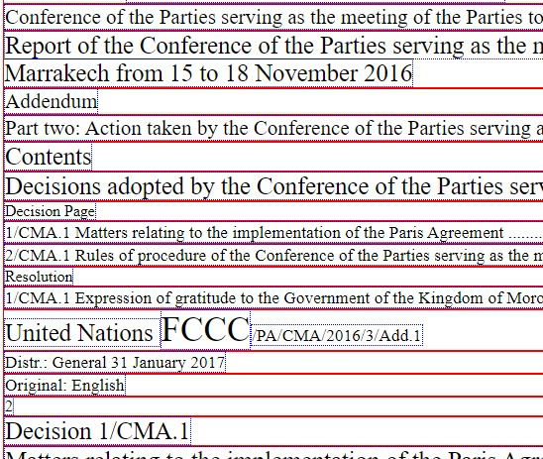
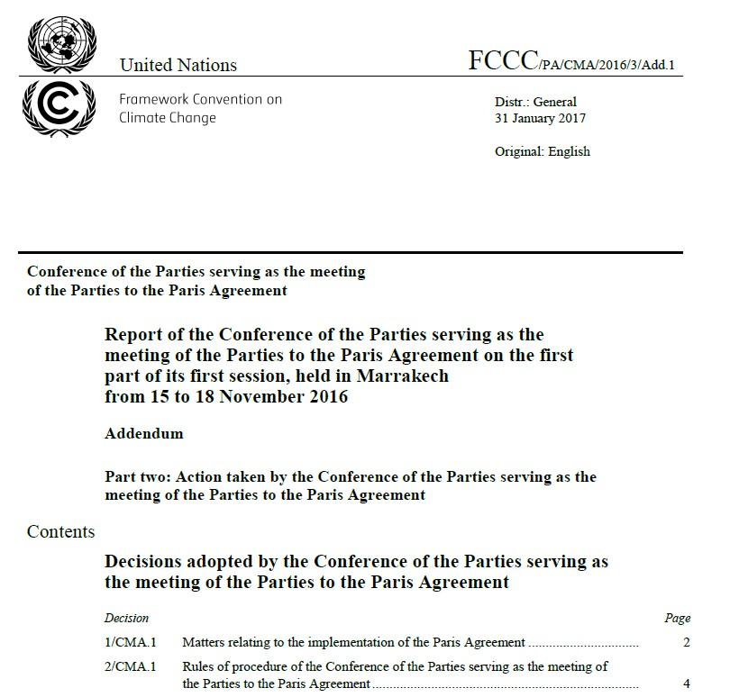
UNFCCC Documents (COP) (5-star)
Datatables(An index for UNFCCC reports)
Reports in semantic HTML
COP Reports in PDF
Notes:
A formal record of each meeting. Lot of jargon both in terms of identifiers and termniologies. They describe the commitments and analysis parties have made each year.

Slide 12
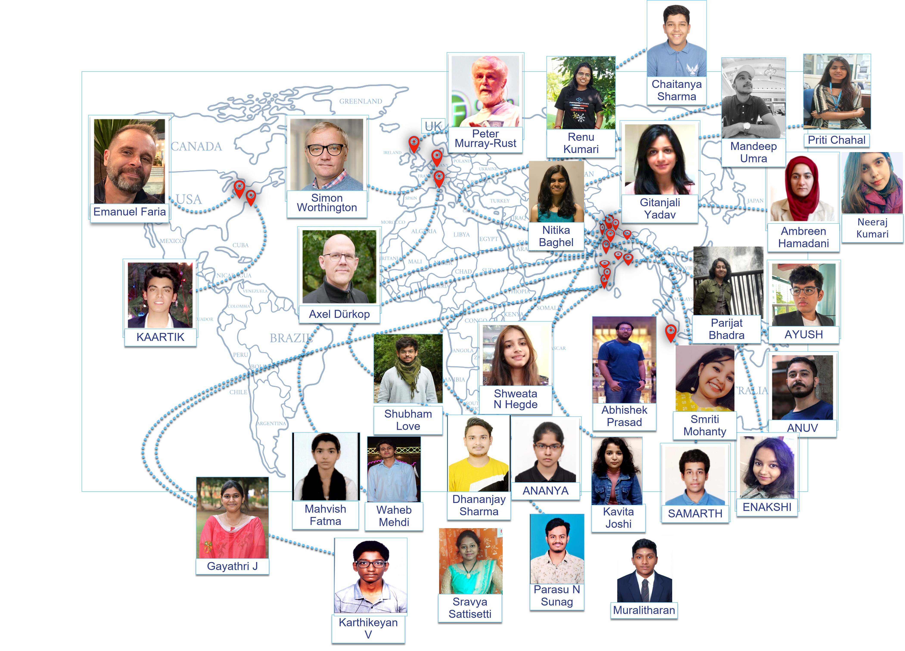
Sustainable Tech is created by Community
Learning by Doing
Internship Programme hosted at the National Institute of Plant Genome Research (NIPGR)

Slide 13
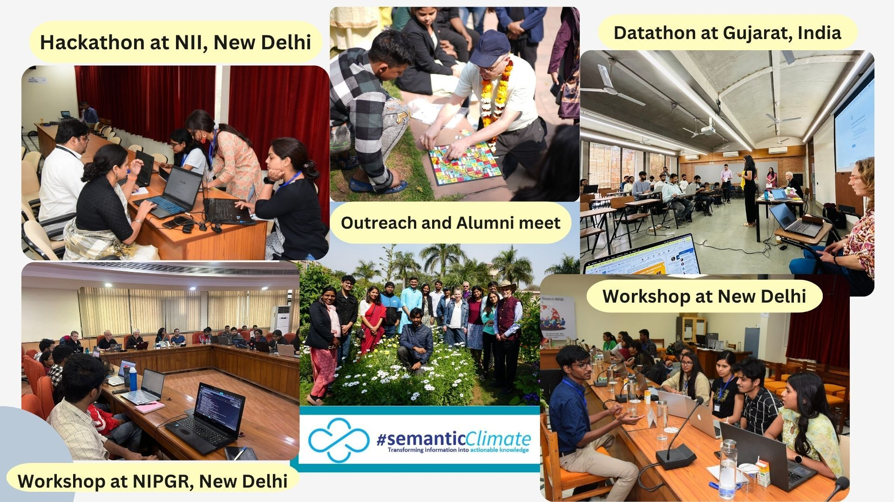
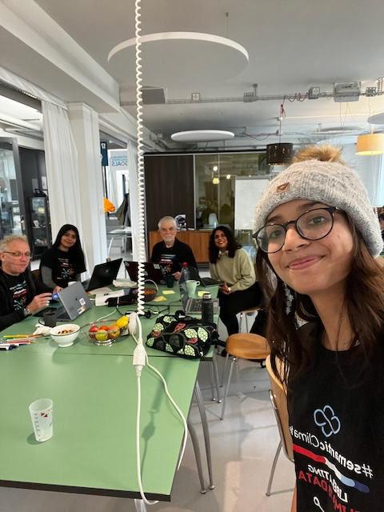
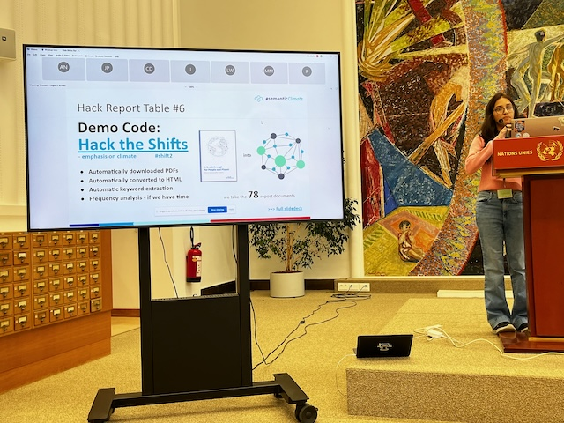
The Tech for the Community: Outreach
UNDatathon, UN Library Hackathon

Slide 14
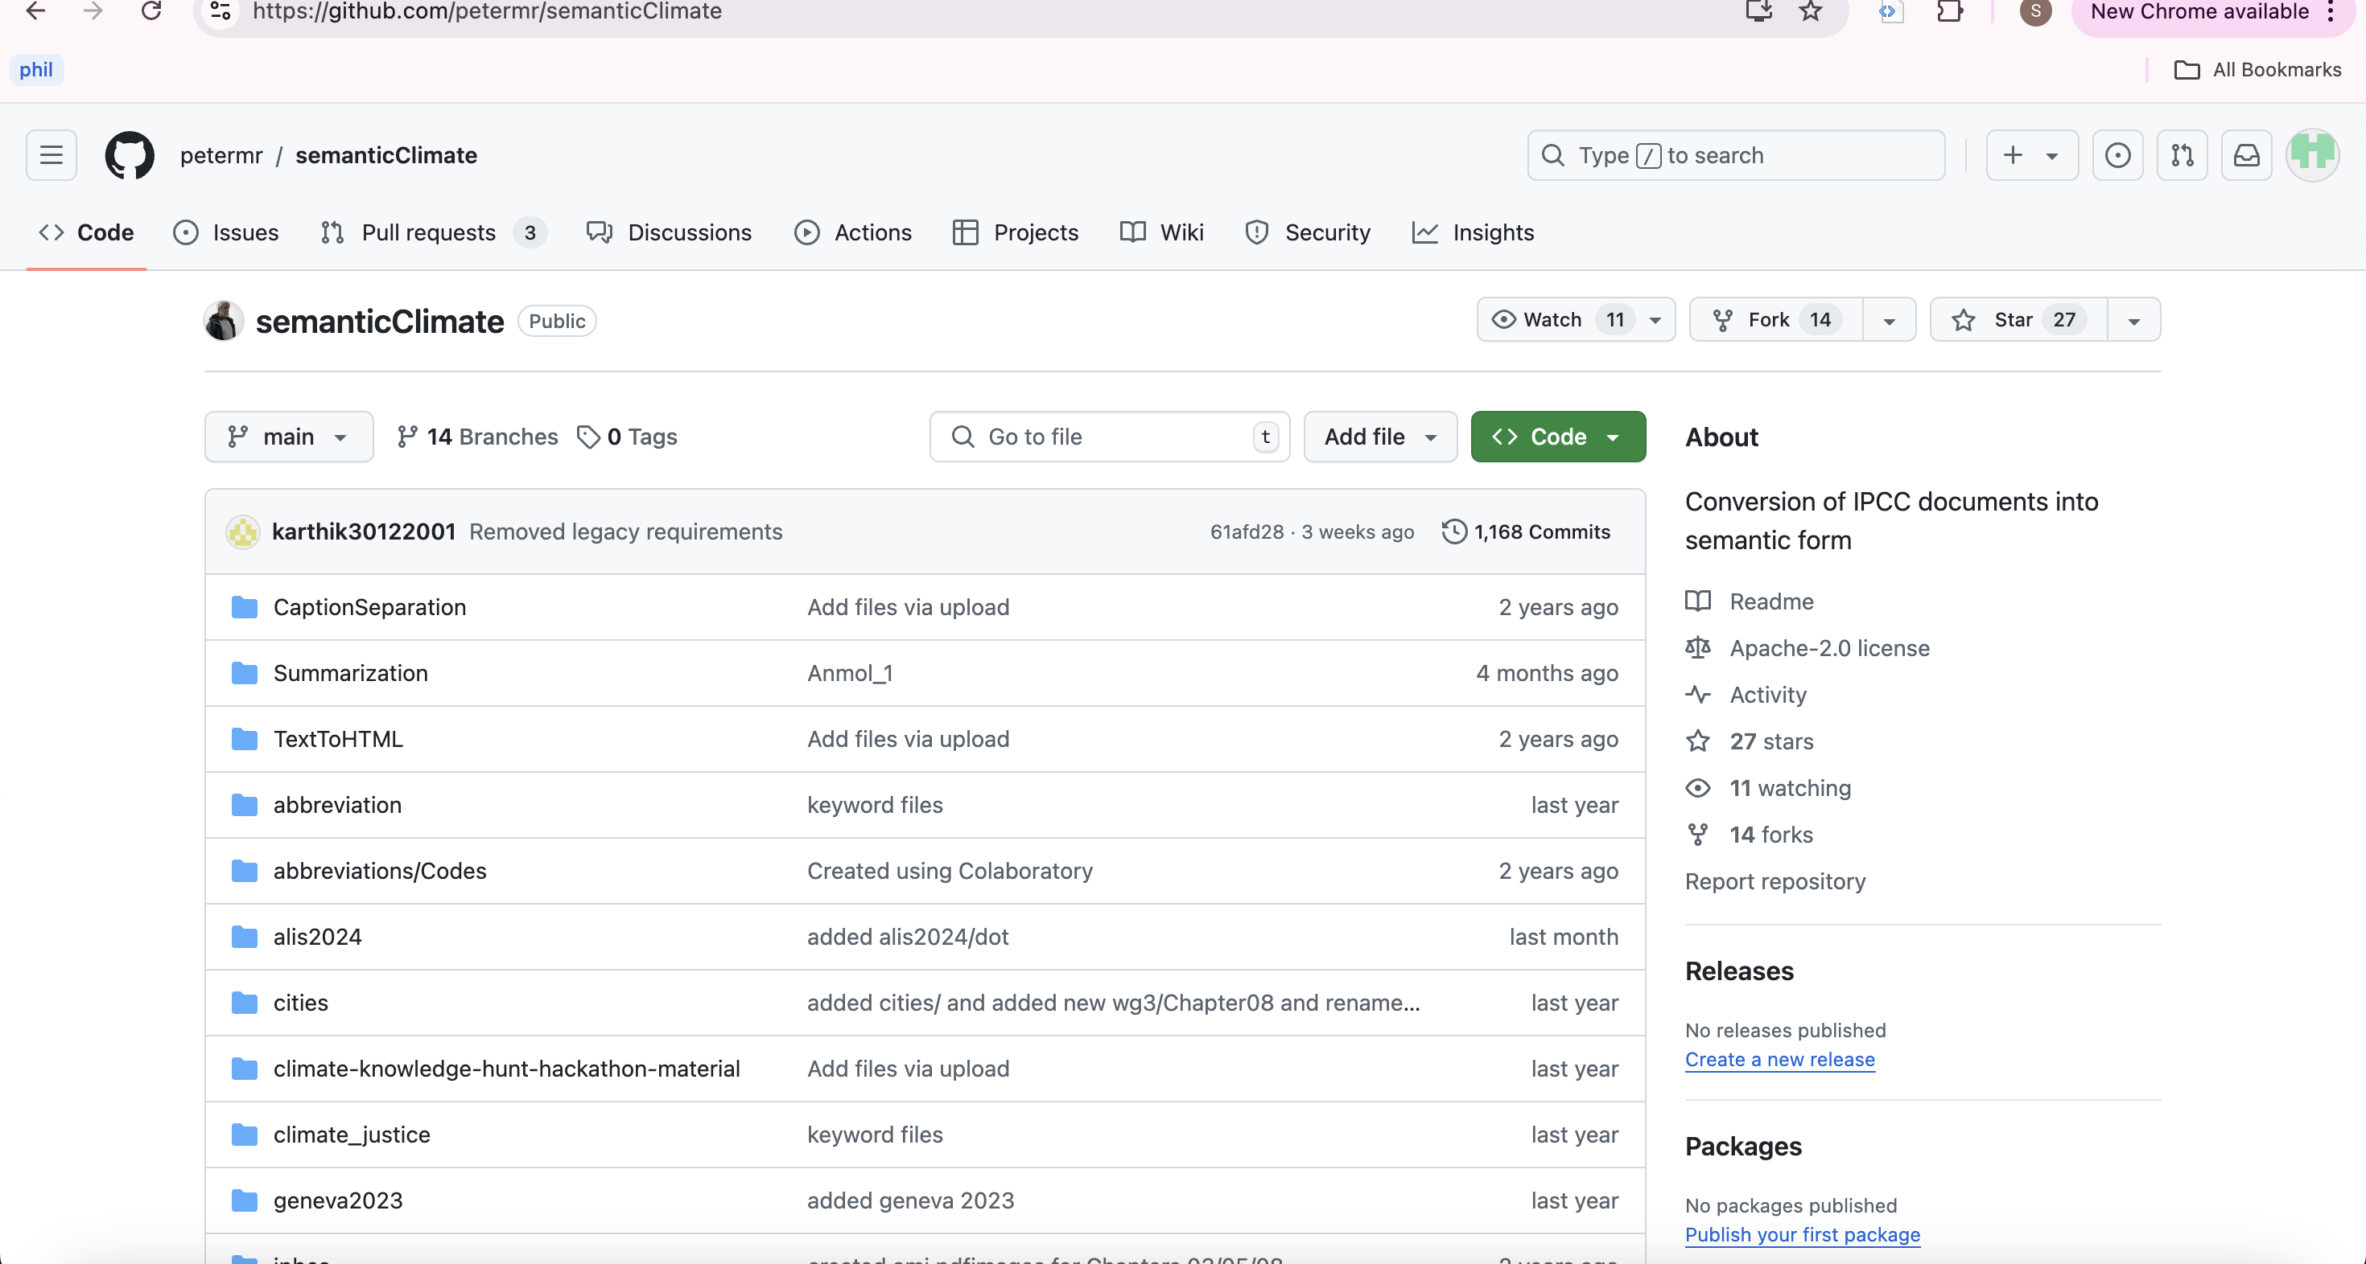
Useful Links
Tools amilib pygetpapers
Products IPCC Glossary Wikibase Instance Semantic IPCC corpus HTML Outputs
Outreach Event highlights
Watch out for demo by our team member, Parijat, on 2024-10-18 at 1100 UTC!

Slide 15
Let’s make climate knowledge 5-star (semantic)!

